Slide 2
CONTENTS: DISASTERS TYPES OF DISASTERS 1.NATURAL DISASTERS FLOODS DROUGHTS EARTHQUAKES CYCLONES 2.MAN-MADE DISASTERS PREVENTION AND SAFETY MEASURES
12.NATURAL DISASTERS

Slide 3
DISASTERS
FORCES OF NATURE THAT CAUSE DESTRUCTION OF LIFE AND PROPERTY ON EARTH ARE CALLED NATURAL DISASTERS

Slide 4
CHAPTER 12/KARUNAMBIGAI/SOCIAL DEPT/SNS ACADEMY

Slide 5
Chapter 4/social/karunambigai/Sns Academy

Slide 6
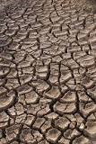
A drought is a period of time when an area or region experiences below-normal precipitation. The lack of adequate precipitation, either rain or snow, can cause reduced soil moisture or groundwater, diminished stream flow, crop damage, and a general water shortage.
DROUGHT

Slide 7
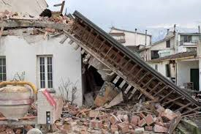
Earthquake, any sudden shaking of the ground caused by the passage of seismic waves through Earth's rocks.
EARTHQUAKE

Slide 8
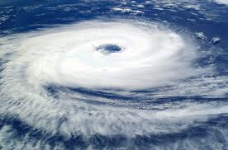
CYCLONES
Cyclones are centred on areas of low atmospheric pressure, usually over warm ocean waters near the equator. The warm moist air over the ocean rises from the surface in the upward direction, resulting in the formation of the low-pressure zone over the surface.

Slide 9
PREVENTION OF FLOODS
Introduce better flood warning systems.
Modify homes and businesses to help them withstand floods.
Construct buildings above flood levels.
Tackle climate change.
Increase spending on flood defences.
Protect wetlands and introduce plant trees strategically.

Slide 10
PREVENTION OF DROUGHT
The first step that we can take to mitigate drought is to understand drought and our environment. It is very important to know where your water comes from to understand how drought might put your water supply at risk We can lose a lot of water doing simple everyday tasks. Did you know that turning off the water while you brush your teeth can save more than 100 gallons of water a month? If you have a leaky faucet, the drips can add up to 300 gallons of wasted water a month. Farmers and businesses are also using new inventions to help them reduce the amount of water they use to grow crops or manufacture things. Businesses, cities, and people are finding new ways to save water by reusing it.

Slide 11
Check yourself and others for injuries. Check water, gas, and electric lines for damage. Turn on the radio. Stay out of damaged buildings. Be careful around broken glass and debris. Be careful of chimneys (they may fall on you). Stay away from beaches. Stay away from damaged areas.
PREVENTION OF EARTHQUAKE

Slide 12
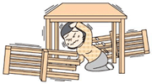
.
PRECAUTION OF EARTHQUAKE
Protect yourself.
Stay away from furniture that could topple over, and hide under a desk or table
.
Do not panic and run outside.

Slide 13
PREVENTION OF CYCLONES
.
Turn off all electricity, gas and water.
Unplug all electrical appliances.
Keep your emergency kit close at hand.
If the building starts to collapse, protect yourself with mattresses, rugs.
Stay tuned to the radio for updates.
Stay inside until told it is safe to go outside.

Slide 14
https://youtu.be/VNgPfjYtzyo

Slide 15
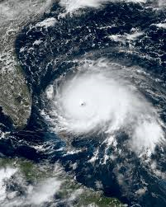
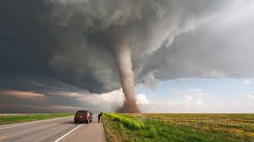
Hurricanes are dangerous and can cause major damage because of storm surge, wind damage, and flooding..

